Slide 1
Panel Chasers
By Anthony Goh

Slide 2
Game Overview
In a tile based world, up to four entities compete to be the last person…er…agent standing.
Overall, it’s an arcade-like game, with an all ages audience.
The controls are simple. Up, down, left, and right are all the buttons used to control the character.

Slide 3
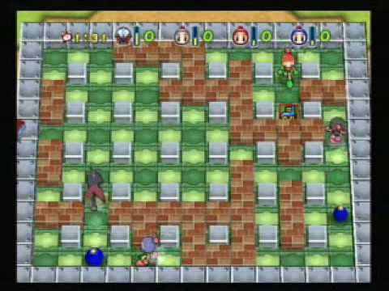
Competitive Analysis
Comparatively, it’s loosely based on the Bomberman series.
The goal of that game is also to kill opponents using bombs and power-up items in a grid-based enviornment.

Slide 4


Items and Terrain
Items appear throughout the game and are to be used in eliminating your opponents.
They are split into 2 types. Attack and support.

Slide 5

Items and Terrain
Terrain includes different types of panels, from normal ones to ones that can instantly kill your character.

Slide 6
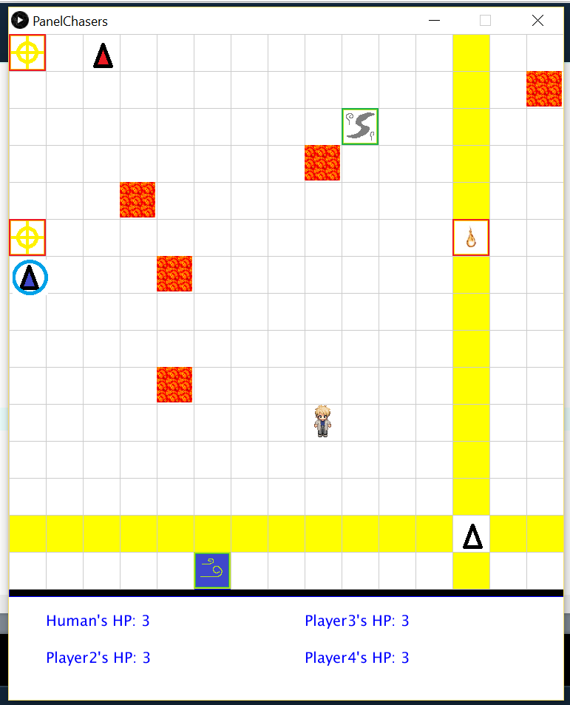
Screenshot

Slide 7
Artificial Intelligence
The AI in this game has only one goal, and two ways to reach it.
It can seek out items to use in an effort to gain an advantage.
And it can try to avoid getting killed by avoiding dangerous areas.

Slide 8
Additional Slides
Added after the presentation. Only contains a partial manual.
REFER TO THE MICROSFT WORD DOCUMENT FOR THE FULL MANUAL.

Slide 9
Manual (pg1:Controls)
REFER TO THE MICROSFT WORD DOCUMENT FOR THE FULL MANUAL.
Arrow Keys to move in Menu and Game.
Enter is select.
Backspace returns to menu from game.

Slide 10
Manual(pg2:Tiles1)
Yellow Tiles indicate danger. They will turn red in a little more than half a second.
Red Tiles are damage tiles, they damage a character standing on them.
Gray Tiles are obstacles, no character can walk through them.

Slide 11
Manual(pg3:Tiles2)
Black Holes instantly kill the unfortunate character on them.
Lava tiles are the same as red tiles. Except they stay permanently on the field.

Slide 12

Manual(pg3)
Attack Items: Works only on blank spaces (includes ones with players on them)
Lightning: Causes 20 random spaces to be struck.
Crosshair: Turns all spaces in all four directions in a straight line yellow.

Slide 13


Manual(pg4)
Quake Items cause yellow tiles to appear in a 3 square radius when obtained.
Fireballs cause a few lava tiles to appear randomly. Technically a “Terrain” Item, not an attack one.

Slide 14

Manual(pg5)
Barrier Items provide a visible barrier that protects the character from 1 hit.
Heart Items restore 1 HP up to 3 HP.

Slide 15


Manual(pg6)
Invisibility Item: Makes your character invisible and immune to everything that isn’t a black hole. Also allows you to walk through obstacles.
Wind: Forces all other characters to move 3 tiles in a random direction. (All in the same direction)

